Slide 1

Phân tích hĐT
Sequence Diagrams
Notes:
NOTE:
To change the image on this slide, select the picture and delete it. Then click the Pictures icon in the placeholder to insert your own image.

Slide 2
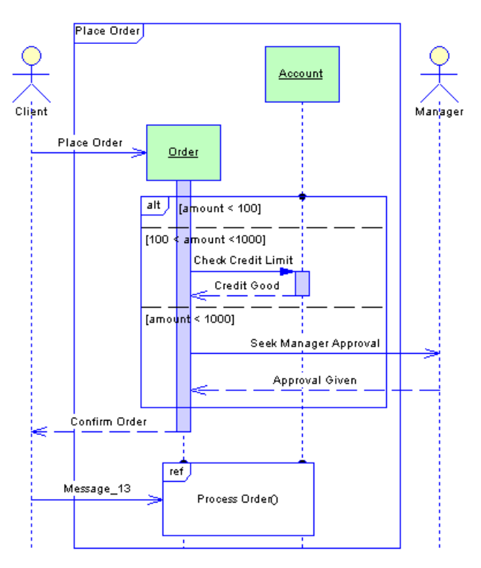
Đọc mô hình sau

Slide 3
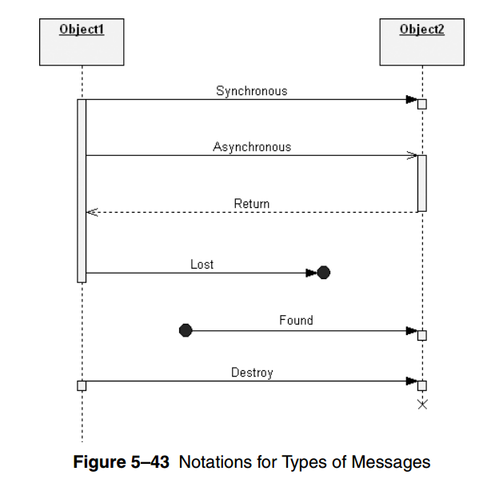
Notation

Slide 4
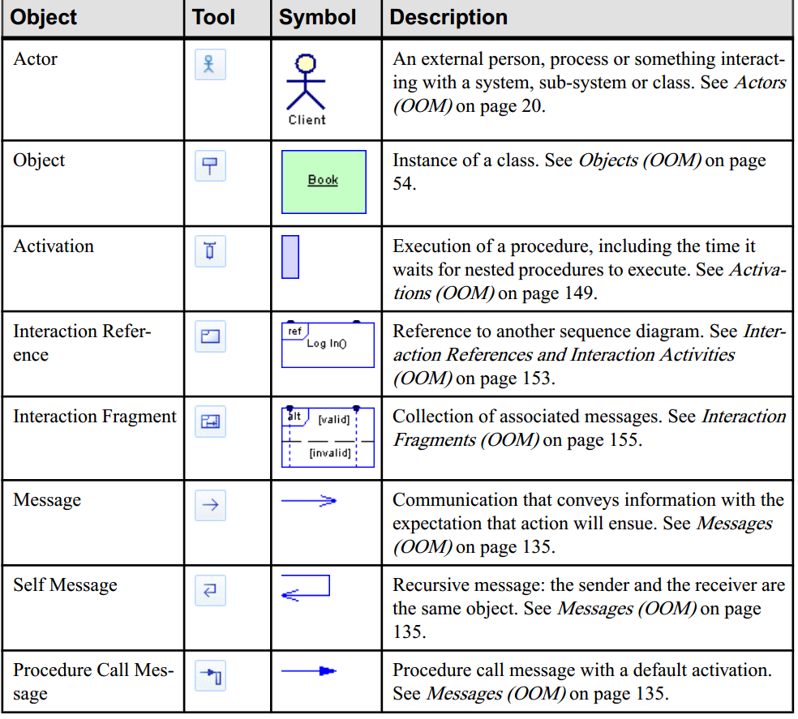
PowerDesign

Slide 5
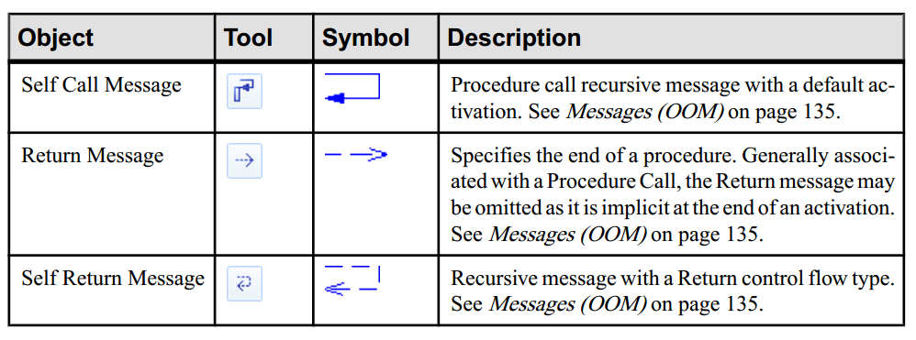
PowerDesign

